Slide 1

BIRCH: An Efficient Clustering Algorithm
BIRCH, or Balanced Iterative Reducing and Clustering Using Hierarchies, is a powerful clustering algorithm designed to handle massive datasets with efficiency. It excels at identifying clusters within large amounts of data, making it a valuable tool in data science and machine learning.

Slide 2
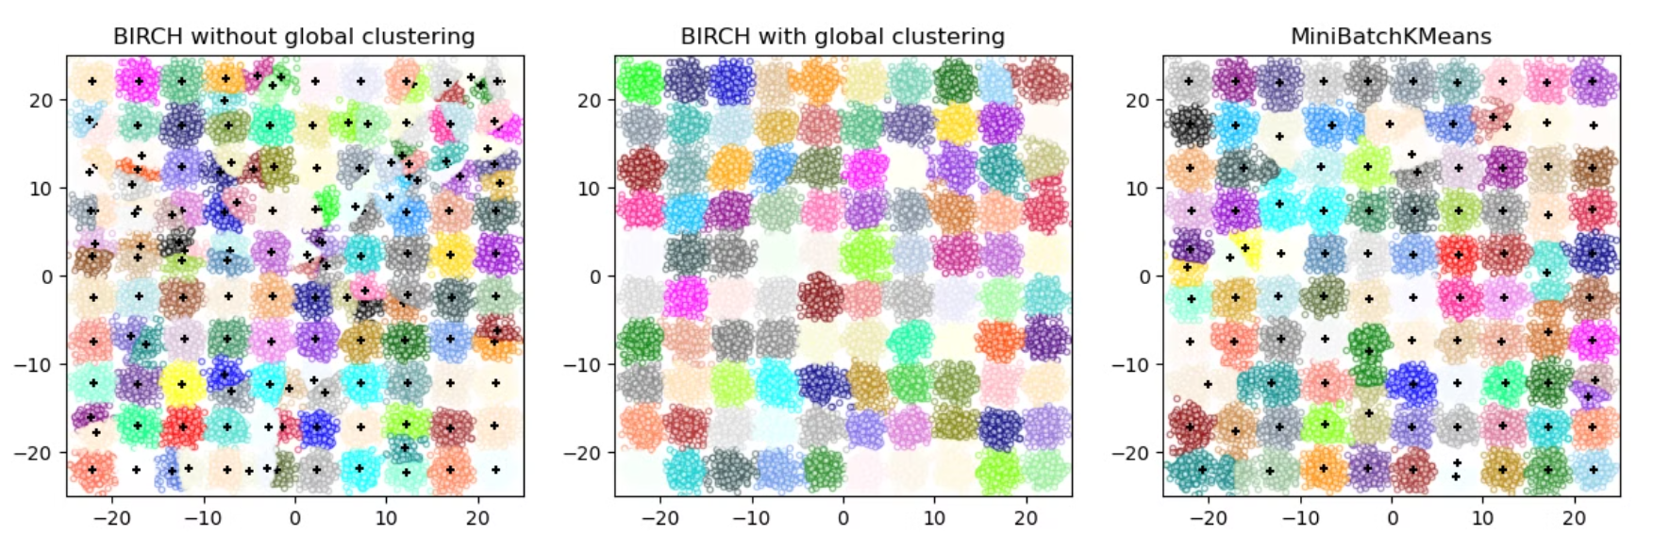
Understanding the CF-Tree
Structure
Nodes
Clustering Feature (CF)
The CF-Tree is a multi-level tree structure designed for efficient storage and retrieval of clustering information.
Leaf nodes store actual data points, while non-leaf nodes store summary information about child nodes.
Each node in the tree is represented by a CF, a tuple containing the cluster's size, sum of points, and sum of squared points.

Slide 3

The BIRCH Algorithm in Action
1
The dataset is scanned, and data points are inserted into the CF-Tree, creating a hierarchical representation of the data.
2
Global clustering performs hierarchical clustering on the CF-Tree, using the summary information stored in the nodes to identify clusters.
3
If needed, micro-clustering further splits large clusters into smaller ones, refining the clustering results to better fit the data.

Slide 4

Benefits and Considerations
Advantages
Disadvantages
BIRCH is known for its efficiency, scalability, and memory efficiency, allowing it to handle large datasets effectively.
Its performance is sensitive to parameter settings, and it assumes spherical clusters, which may not be ideal for complex shapes.

